Slide 1



Leveraging Generative AI for Carbon Footprint Tracking and Food Waste Reduction in Retail
Presented By:
Ankita Saxena 24206979
Pravesh Rana 24205030
Ratnesh Singh 24206757

Slide 2





Team Members
Ankita Saxena
Ratnesh Singh
Pravesh Rana
Notes:
I’m Ankita Saxena, joined by Pravesh Rana and Ratnesh Singh."

Slide 3


01 | Overview
02 | Objectives & Strategic Goals
03 | Problem Statement
04 | Gap Analysis
04 | Timeline
05 | Solution Architecture
06 | End-to-End Process Flow
07 | Tools & Technologies
08 | Value Proposition & Business Benefits
09 | Key Challenges
10 | Key Takeaways
11 | Demo
Agenda.
02

Slide 4

Overview.
Tackling food waste and carbon emissions across Irish retail supply chains
Leveraging Generative AI for real-time waste analytics and insights
Addressing the gap to meet Ireland’s 2025 sustainability targets
Delivering measurable value for both business and environment
A GenAI-powered solution to help Irish retailers track, reduce, and report food waste for a greener, more sustainable future.
03

Slide 5





Objectives & Strategic Goals
Quantify & Track Carbon Footprint
Enable Actionable GenAI Insights
Drive Progress Toward 2025 EU Targets
Automate the data collection and reporting processes for all major waste streams through dashboards.
Implement real-time alerts and perform scenario analyses to enhance waste reduction efforts.
Benchmark and report on compliance at both the store and national levels.
Our solution integrates analytics, artificial intelligence, and environmental, social, and governance (ESG) compliance to deliver measurable value for both retailers and the environment.
Source: EEA
04

Slide 6







Problem Statement.
Regulatory pressure from EU 2025 targets and increasing demand for sustainability transparency require actionable, automated, and trackable reporting mechanisms.
16% Landfill Usage
Food Waste
2025 Deadline
Retail Store
Food Waste
Unknown CO₂ Impact
Regulation vs. Retail Insight Gap
Source: EPA
05

Slide 7
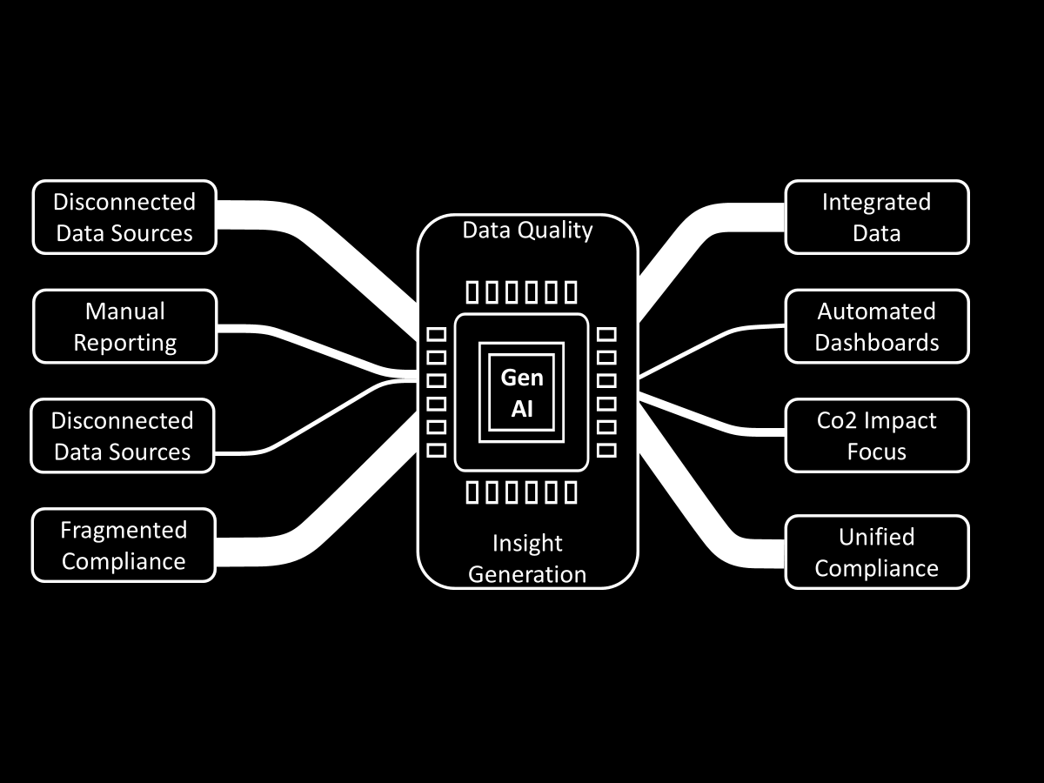
Gap Analysis.
Current State
Target State
Gap
06

Slide 8
Timeline.
Initiation
Execution
Closure
Conduct research and shortlist ideas.
Define project scope and finalize dataset.
Schedule meetings with supervisor and prepare draft report.
Data cleaning and proof of concept (PoC) development
Generation of the AI model and creation of the dashboard
Initial review of the dashboard
Conduct stakeholder review
Finalize the dashboard
Submit the presentation and accompanying report
07

Slide 9






Solution Architecture.
The architecture integrates multiple data sources, generative AI analytics, and business intelligence to deliver real-time, actionable insights for retailers and stakeholders.
Data Sources
Data Integration Layer
GenAI Processing & Logic
Dashboard & Reporting Layer
User Interface
Retail waste, inventory, and sales systems
ETL (Extract, Transform, Load) process for cleaning and standardizing data
Core analytics, scenario modeling, and chatbot powered by generative AI
Microsoft Power BI for visualization and interactive reporting
Web application dashboard and AI-powered chatbot interface
08

Slide 10

End-to-End Process Flow.
Our Solution follows a clear, step-by-step process to drive measurable results
Data Input & Integration
GenAI Web App Processing
CO₂ Savings Calculation
Dashboard & Reporting Layer
Store-Level Action
Collect and standardize data from retail waste, inventory, and sales sources.
Apply generative AI algorithms to analyze waste streams, identify trends, and generate actionable insights.
Deliver real-time alerts and recommendations directly to store managers for immediate response.
Quantify emissions reductions and track progress toward sustainability goals.
Visualize KPIs, track performance gaps, and enable continuous improvement through interactive dashboards.
09

Slide 11



Tools & Technologies.
Our technology stack combines AI, cloud-based analytics, and user-friendly interfaces for robust performance and scalability.
Gemini API
Microsoft Power BI
Powers the Web App. Chatbot, enabling expiry alerts, manager queries, and dynamic promotion suggestions.
Builds and publishes interactive dashboards with real-time waste KPIs and CO₂ emissions tracking.
Microsoft Fabric (Copilot):
Python
Integrates AI- driven Insights and allows natural language querying for business users.
Implements core logic for the web application and CO₂ emissions calculations.
10

Slide 12




Value Proposition & Business Benefits.
ESG Reporting Compliance
Sustainability Impact
Simplifies carbon and waste reporting for EU and local mandates
Enables measurable CO₂ reductions and waste diversion
Operational Efficiency
Competitive Advantage
Store teams receive actionable, data-driven recommendations in real time
Supports brand reputation as a sustainability leader
11

Slide 13




Key Challenges.
Synthetic Data Basis
Cost of RFID Infrastructure
User Adoption and Integration
Model Scope
Results modeled on simulated data due to limited access to real retailer records
Initial cost of tags and scanners needs to be calculated
Real world integration and appropriate staff training for GenAI solutions
Current focus on food waste; broader waste streams (packaging, etc.) are out of scope
12

Slide 14



Key Takeaways.
GenAI empowers retail teams with real-time, actionable insights to cut waste and emissions.
The solution directly supports Ireland’s journey to EU 2025 waste & carbon targets.
Scaling this approach unlocks ESG, operational, and reputational value for retailers.
13

Slide 15


Demo: Dashboard & GenAI Web App.
Microsoft Power BI
Gen AI Web App
14

Slide 16
Thank You.
15

Slide 17

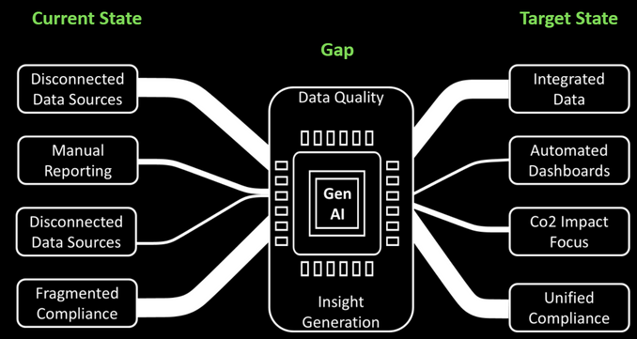
MSc Business Analytics
Capstone Project
Leveraging Generative AI for Carbon Footprint Tracking and Food Waste Reduction in Retail
Problem Statement.
Gap Analysis.
Regulatory pressure from EU 2025 targets and increasing demand for sustainability transparency require actionable, automated, and trackable reporting mechanisms.
16% Landfill Usage
Key Results.
Food Waste
2025 Deadline
Recycling rate: 40.4% (EPA) vs 55% Target 2025.
Landfill use: 16% vs EU limit 10%.
Food waste capture rate: 8%.
Simulated CO₂ savings visualized.
Retail Store
Food Waste
Unknown CO₂ Impact
Regulation vs. Retail Insight Gap
Source: EPA
End-to-End Process Flow.
Value Proposition & Business Benefits.
Our Solution follows a clear, step-by-step process to drive measurable results
Summary.
ESG Reporting Compliance
Sustainability Impact
Data Input & Integration
GenAI Web App Processing
Store-Level Action
CO₂ Savings Calculation
Dashboard & Reporting Layer
Simplifies carbon and waste reporting for EU and local mandates
Enables measurable CO₂ reductions and waste diversion
Our GenAI-powered platform integrates fragmented retail data to provide real-time actionable insights via AI chatbot and Power BI dashboards.
This enables Irish retailers to track and reduce food waste and carbon emissions effectively, supporting compliance with EU 2025 sustainability targets.
The solution delivers measurable ESG impact and operational efficiencies, advancing Ireland’s environmental commitments.
Collect and standardize data from retail waste, inventory, and sales sources.
Apply generative AI algorithms to analyze waste streams, identify trends, and generate actionable insights.
Deliver real-time alerts and recommendations directly to store managers for immediate response.
Quantify emissions reductions and track progress toward sustainability goals.
Visualize KPIs, track performance gaps, and enable continuous improvement through interactive dashboards.
Operational Efficiency
Competitive Advantage
Store teams receive actionable, data-driven recommendations in real time
Supports brand reputation as a sustainability leader
Presented By:
Supervisor:
Dr. Matt Glowatz
Deloitte
Saul Carolan
Ankita Saxena 24206979
Pravesh Rana 24205030
Ratnesh Singh 24206757
Sponsor:
Sponsor PoC:

